Slide 1
Interfaces parallel, serial

Slide 2
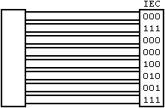
Parallel Interface
What
  Signal is transmitted on several lines
    Signal bits spread out – in sync, in parallel
Pros
  Higher speed of transmission (throughput)
    Due to multiple lines carrying bits
  Simpler to code
    Since register lengths map out to signal lines
Cons
  Very high cost (in terms of pin and PCBA-layout real estate)
  High ISI (inter signal interference) - due to line proximity
  Signal boosting (for long distance travel) is expensive

Slide 3
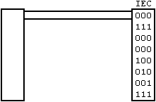
Serial interface
What
  Signal is transmitted on a single line (not counting ground)
    Signal bits sent out one after another – serially
Pros
  Much lower cost due to lesser number of lines
  No ISI (inter signal interference)
  Signal boosting (for long distance travel) is simpler
Cons
  Low throughput
    Has to be boosted using very high speed clocks
  Handshake options have to be pre-determined
    LSB-first / MSB-first, etc.
  Challenge to code
    Need to handle SerDes (serializing – deserializing)

Slide 4

Serial – Transmission modes
Simplex
  One-way communication
  Only one device talks, the other only listens
Half-duplex
  Two-way communication
  Both devices can talk, but only one at a time
Full-duplex
  Two-way communication
  Both devices can talk simultaneously

Slide 5
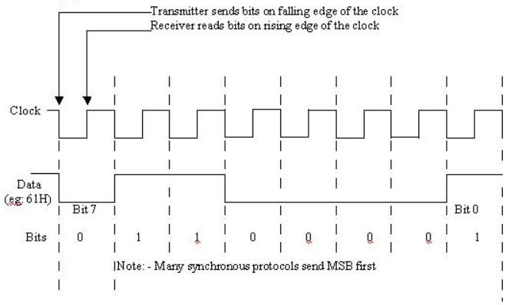
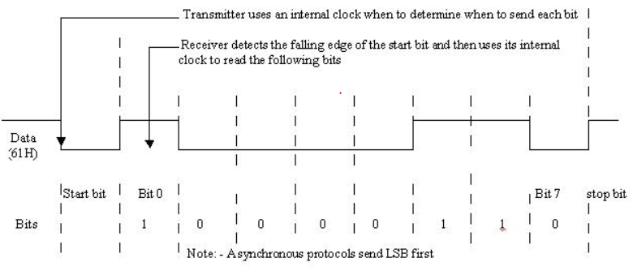
Serial – Signaling
Synchronous
  Has a Reference Clock shared
  Additional expense!
Asynchronous
  No Clock signal shared
  Extra START/STOP markers!
Pay-load

Slide 6
Serial bus – uart (RS-232)

Slide 7
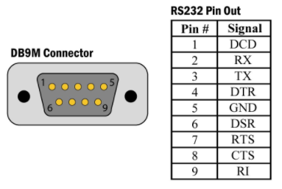
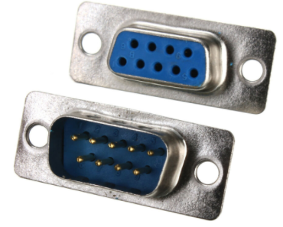
UART & RS-232 standard
UART: Universal Asynchronous Receiver Transmitter
Frame format : start bit , payload , stop bit
RS-232: Recommended Standard #232
  Defined in 1960 as a serial communication standard
  Intended for signaling between DTE (PC) and DCE (modem)
  Original standard defined 25 signals, but only 3 are used today
    RX (Receive), TX (Transmit), GND (Ground)
  Connectors:
    Old: DB-25, New: DB-9
Female
Male

Slide 8
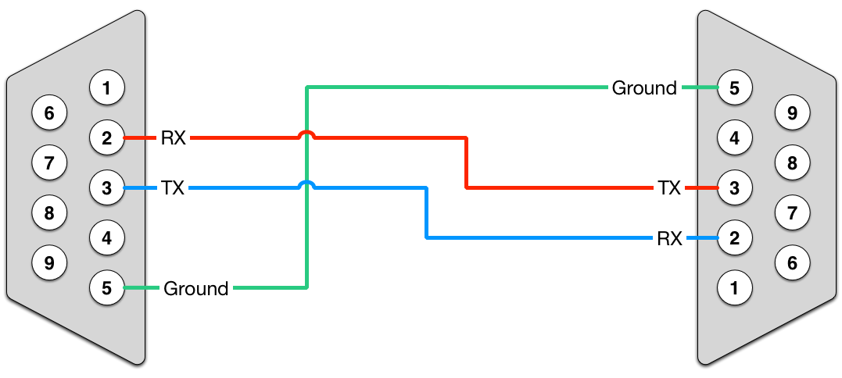
RS-232: Bus wiring
Device 1’s RX will go into Device 2’s TX
  And vice-versa
Common ground

Slide 9
RS-232: Bus voltages, MCU interfacing
RS-232 voltage levels TTL voltage levels
+25V
Logic 0
5V
Logic 1
+3V
2V
0.8V
Logic 0
0V
-3V
Logic 1
Level shifting
(MAX232)
-25V

Slide 10
RS-232: Bus Nomenclature
Terminology
Examples
Baud Rate
  Speed at which data travels
  Most common: 9600 baud
Payload size
  Size of ‘data payload’
  Most common: 8-bit
Parity
  Extra bits added for detecting effects of noise
  Odd (O), Even (E) or None (N)
Stop bits
  Extra bits to serve as stop markers
  Note: Start marker is always 1-bit (0)
9600/8-N-1
57600/8-E-1
115200/8-O-2
10-bit packet
11-bit packet
12-bit packet

Slide 11
RS-232: Limitations
Large connectors
  Out of place with today’s equipment
Low noise immunity
  Due to single-ended signaling
Low transmission speed
  Less throughput
Short maximum cable length
  ~15m (subject to noise conditions and line capacitance)
Large voltages and voltage swings
  TTL-incompatible, needs drivers
No multi-point capability
  Point-to-point (P2P) bus

